Slide 1
How to fill out the Parent’s Financial Statement
Section 7 – Uploads & Payment

Slide 2
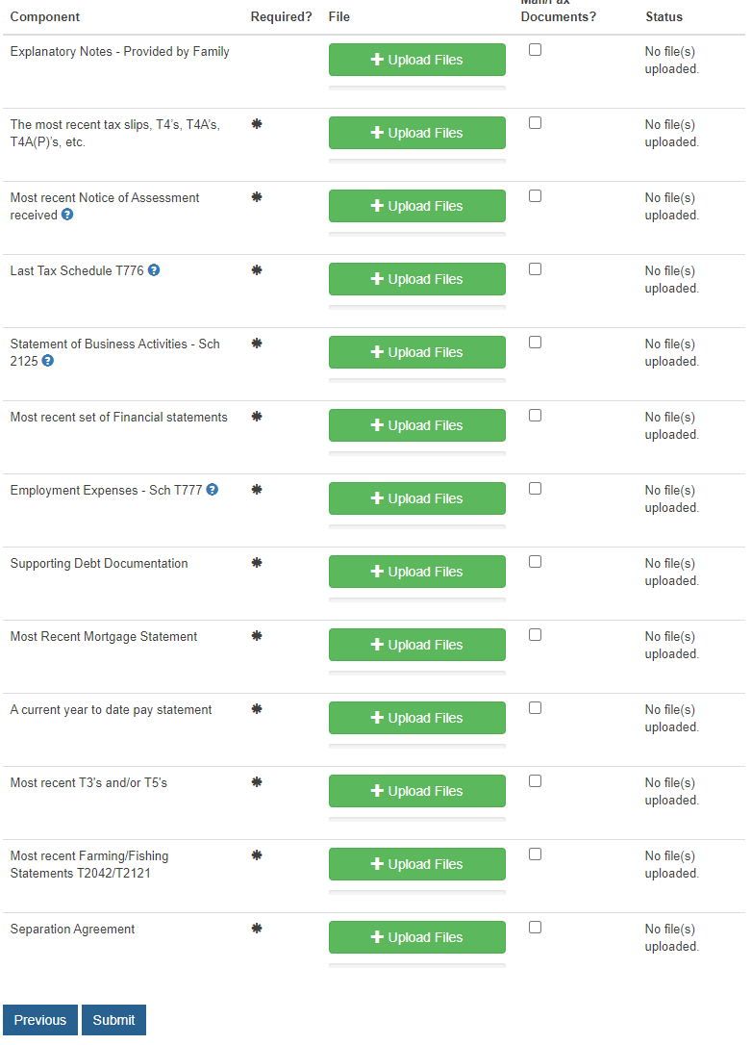
Upload Page
  This page appears once the application has been completed and allows you to upload any and all supporting documents that will be required for us to complete our analysis
    If you are unable to upload your documents and/or do not wish to transmit them electronically, they can be either faxed or mailed. Simply tick the box labelled Mail/Fax documents next to each category that you intend to mail or fax in order to be able to continue to the next step.
      NOTE: All provided documentation will be uploaded to our system, and is transmitted electronically to the school(s) selected through our secure system
    This will necessarily delay the process as we will be unable to continue until the documents arrive
  Not all the sections shown to the right will appear on your application, only those sections related to the document(s) you need to upload as per the fields filled out on your application will appear
  NOTE: Supporting documentation is required for Apple Financial Services to complete their analysis of each application, and uploading these documents along with your application is the quickest way to move through the process.

Slide 3
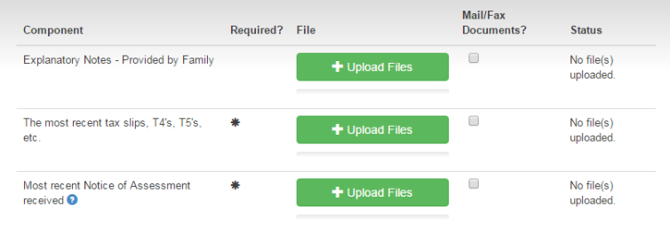
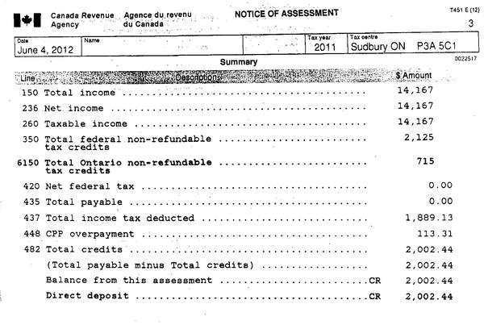
Upload Page - 1
  Explanatory Notes
    You may create a document and upload it here if you feel that there are additional details that were not captured on the application that would be relevant to our analysis. This is not a mandatory document to provide
  The most recent tax slips, T4’s T5’s etc..
    T4’s are required if you noted any income in Section 10 A/B and/or 10 C
  Most Recent Notice of Assessment received
    This document is always required and refers to the Revenue Canada Notice of Assessment as opposed to any property Notice(s) of Assessment you may have received.
    Opposite this text is an example of the Revenue Canada Notice of Assessment
    NOTE: We will require the Notice of Assessment for all family members who are listed on the application regardless of employment status

Slide 4
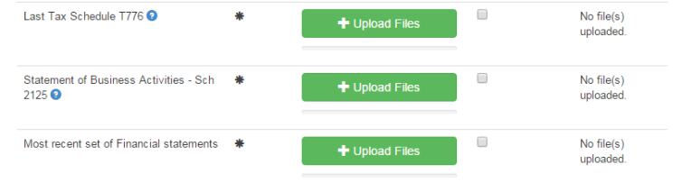
Upload Page - 2
  Last Tax Schedule T776
    This is required if you indicated that you receive rental income anywhere on the application. This document would have been submitted with your most recent tax return.
    Both the summary page as well as all the detail pages of this document will be required
    Here is a link to the Revenue Canada website showing an example: https://www.canada.ca/en/revenue-agency/services/forms-publications/forms/t776.html
  Statement of Business Activities – Sch 2125
    This is required if you indicated that you receive self-employment income anywhere on the application. This document would have been submitted with your most recent tax return.
    Both the summary page as well as all the detail pages of this document will be required
    Here is a link to the Revenue Canada website showing an example: https://www.canada.ca/en/revenue-agency/services/forms-publications/forms/t2125.html
  Most recent set of Financial Statements
    These will be required if you indicated that you either have ownership in a corporation and/or receive income from a corporation that you own
    NOTE: Financial Statements are not required if you are self-employed and your business is not incorporated
    NOTE: If more that one corporation is owned, copies of the Financial Statements for all corporations will be required
  T2 GIFI Schedule 50
    If you own between 20% and 100% of a corporation, we will require a copy of your GIFI Schedule 50 which would have been part of your most recent T2 Corporate Tax Return

Slide 5
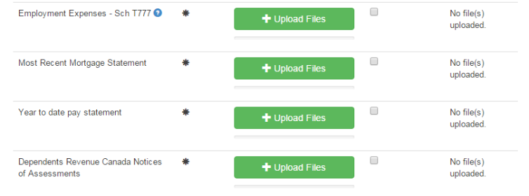
Upload Page - 3
  Employment Expenses – Sch T777
    This is required if you indicated that you have employment expenses that can be written off in Section to A/B. This document would have been submitted with your most recent tax return.
    Both the summary page as well as all the detail pages of this document will be required
    Here is a link to the Revenue Canada website showing an example: https://www.canada.ca/en/revenue-agency/services/forms-publications/forms/t777.html
  Most Recent Mortgage Statement
    This is required if you indicated that you have a mortgage on any property that you own.
    You should receive an annual statement from your financial institution showing the current balance, payment amounts and frequency of payments
  Year to date pay statement
    A copy of the most recent pay statement(s) for all individuals noted to be receiving income from an employer will be required.
    This document should clearly show the year to date amount of payments received as well as the payment received for the current pay period
  Dependents Revenue Canada Notices of Assessment
    These documents will be required if you indicated anywhere on the application that your dependents either file taxes and/or receive income. An example document is shown on “Upload Page – 1”

Slide 6
Upload Page - 4
  Most recent T3’s and/or T5’s
    T3’s and/or T5’s are required depending on the income you noted in Section 10 F, 10 G and/or 10 H
  Most recent Farming/Fishing Statements T2040/T2121
    Both the summary page as well as all the detail pages of this document will be required
    Here is a link to the Revenue Canada website showing an example of the statement of Farming Activities: https://www.canada.ca/en/revenue-agency/services/forms-publications/forms/t2042.html
    Here is a link to the Revenue Canada website showing an example of the statement of Fishing Activities: https://www.canada.ca/en/revenue-agency/services/forms-publications/forms/t2121.html
  Separation Agreement
    If you have a formal separation agreement with the other parent of your child, please provide here any relevant sections dealing with child/spousal support, education and/or section 7 expenses.

Slide 7
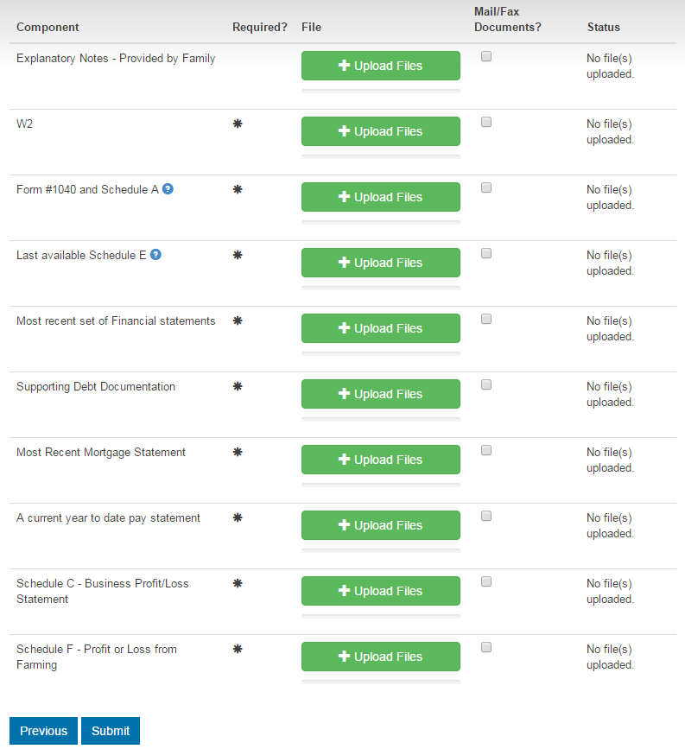
US Applicant Upload Page
  Below is a list of Canadian tax documents referred to throughout the preceding documents, and the US equivalents that will be required in their place
Canadian Document | US Document
T4, T4(A), T4(P) | W2
Revenue Canada Notice of Assessment | Form #1040 and Schedule A
Statement of Real Estate Rentals – T776 | Schedule E – Supplemental Income and Loss
Dependents Revenue Canada Notice of Assessment | Dependents most recent 1040 Summary
Statement of Business or Professional Activities – T2125 | Schedule C – Business Profit/Loss Statement
Statement of Farming/Fishing Activities | Schedule F – Profit or Loss from Farming Fishing activities reported on your Schedule C as a self-employed business

Slide 8
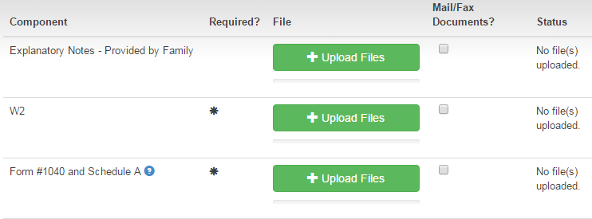
US Applicant Upload Page - 1
  Explanatory Notes
    You may create a document and upload it here if you feel that there are additional details that were not captured on the application that would be relevant to our analysis. This is not a mandatory document to provide
  W2
    W2’s are required if you noted any income in Section 10 A/B
  Form # 1040 and Schedule A
    This document is always required and refers to the most recent tax return (Form #1040) that you filed
    Below is a link to the IRS website showing a Form # 1040 http://www.irs.gov/pub/irs-pdf/f1040.pdf

Slide 9
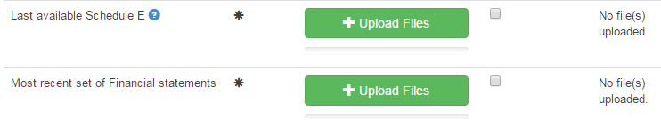
US Applicant Upload Page - 2
  Last available Schedule E
    This is required if you indicated that you receive rental income anywhere on the application. This document would have been submitted with your most recent tax return.
    Here is a link to the IRS website showing an example: http://www.irs.gov/pub/irs-pdf/f1040se.pdf
  Most recent set of Financial Statements
    These will be required if you indicated that you either have ownership in a corporation and/or receive income from a corporation that you own
    NOTE: Financial Statements are not required if you are self-employed and your business is not incorporated
    NOTE: If more that one corporation is owned, copies of the Financial Statements for all corporations will be required

Slide 10
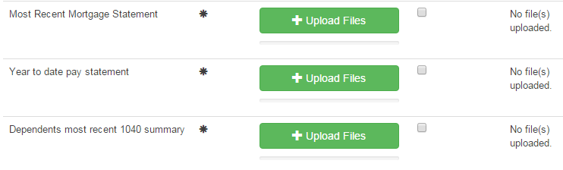
US Applicant Upload Page - 3
  Most Recent Mortgage Statement
    This is required if you indicated that you have a mortgage on any property that you own.
    You should receive an annual statement from your financial institution showing the current balance, payment amounts and frequency of payments
  Year to date pay statement
    A copy of the most recent pay statement(s) for all individuals noted to be receiving income from an employer will be required.
    This document should clearly show the year to date amount of payments received as well as the payment received for the current pay period
  Dependents most recent 1040 summary
    These documents will be required if you indicated anywhere on the application that your dependents either file taxes and/or receive income. An example document is shown on “US Applicant Upload Page – 1”

Slide 11
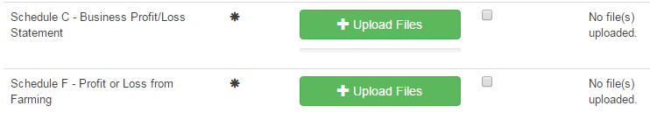
US Applicant Upload Page - 4
  Schedule C – Business Profit/Loss Statement
    This is required if you indicated that you receive self-employment income anywhere on the application. This document would have been submitted with your most recent tax return.
    Here is a link to the IRS website showing an example: http://www.irs.gov/pub/irs-pdf/f1040sc.pdf
  Schedule F – Profit or Loss from Farming
    This is requires if you indicated that you receive income from Farming in Section 10 O
    Here is a link to the IRS website showing an example: http://www.irs.gov/pub/irs-pdf/f1040sf.pdf

Slide 12
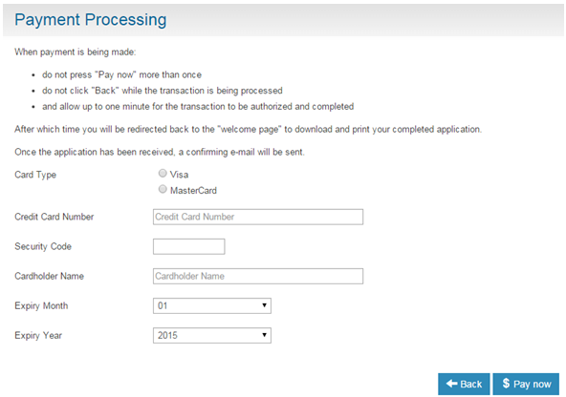
Payment Page
  Once the application has been completed and all documents either uploaded and/or marked to be mailed or faxed to Apple Financial Services, you will move to the payment page where you can pay by credit card for the service.
  If you do not posses a credit card, you can purchase pre-loaded credit cards at many institutions, and use one of those to pay for our services
  If neither of the above options are applicable, you may save your application at this point and send a cheque made out to AFS FACS Inc. Once the cheque is received, AFS will move your application along to the next step in the process. NOTE: This will necessarily delay the process due to the time taken for the cheque to arrive at Apple Financial Services

